Slide 1
Independent T-tests

Slide 2

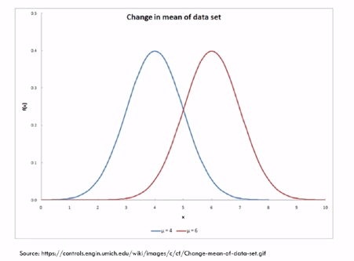
Visual representation b/w 2 means of independent populations

Slide 3
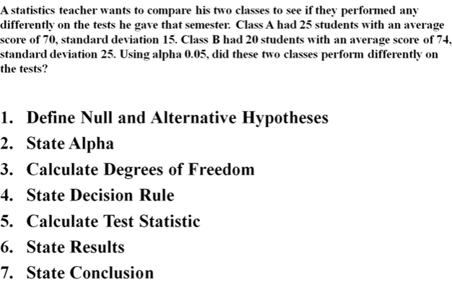
Example for :Independence T-test

Slide 4
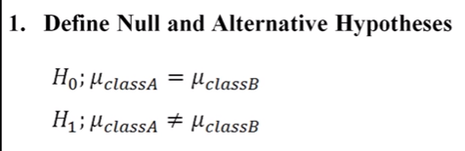

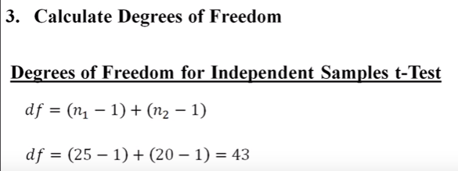

Slide 5
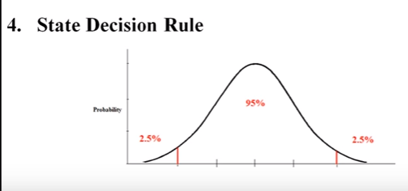

Slide 6
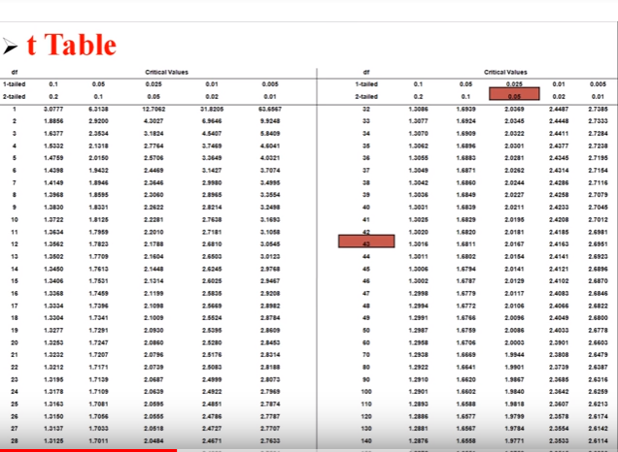
Critical value is 2.017 from t table

Slide 7
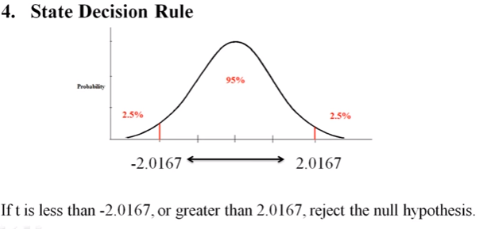

Slide 8
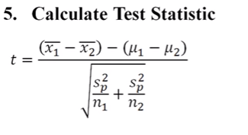
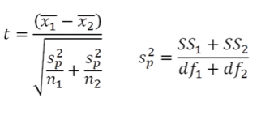

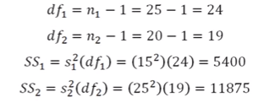

Slide 9
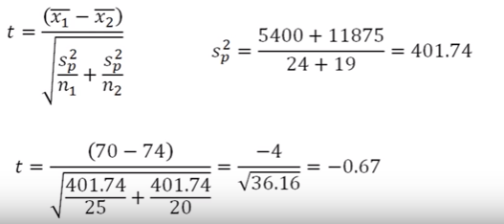
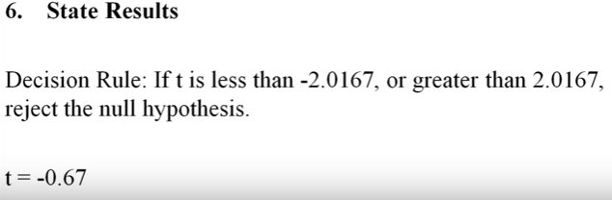

Result do not reject Ho
We conclude that there is no difference between class A and class B

Slide 10
X<- head(read.csv("d:/mf.csv"))
Mfacebookusage Ffacebookusage
1 19 25
2 30 1
3 5 11
4 13 17
5 12 4
6 11 4
> head(x$Mfacebookusage)
[1] 19 30 5 13 12 11
> head(x$Ffacebookusage)
[1] 25 1 11 17 4 4
Hist(x$Mfacebookusage)

Slide 11
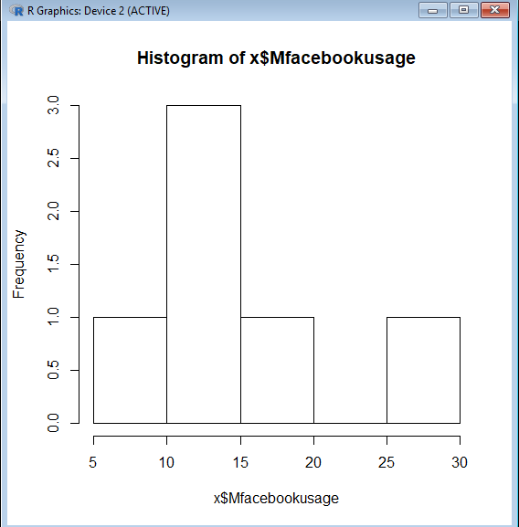
> hist(x$Mfacebookusage)
>

Slide 12
> t.test(x$Mfacebookusage,x$Ffacebookusage)
Welch Two Sample t-test
data: x$Mfacebookusage and x$Ffacebookusage
t = 0.90521, df = 9.9486, p-value = 0.3868
alternative hypothesis: true difference in means is not equal to 0
95 percent confidence interval:
-6.828256 16.161589
sample estimates:
mean of x mean of y
15.00000 10.33333
>

Slide 13
T-statistics = 0.90521
P value is >0.05 we would fail to reject the null hypothesis that means of these 2 groups are equal.
95%confidence
Mean hrs of male usage of book is 1:15
Mean hrs of female usage of book is 10.33

Slide 14
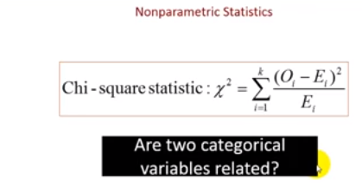
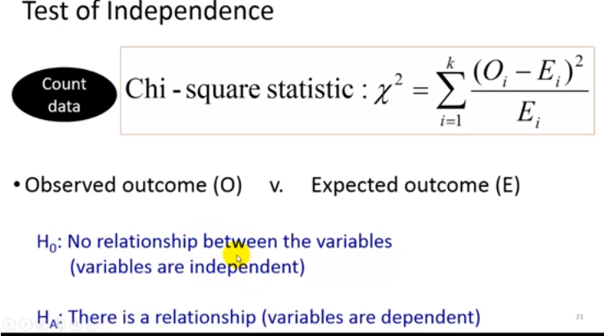
CHI-SQUARED TEST OF INDEPENDENCE

Slide 15
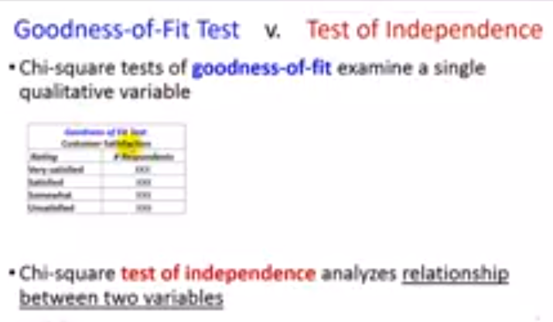
Chi-square tests of goodness-of-fit examine a single qualitative variable
Chi-square test of independence analyses relationship between 2 variables

Slide 16
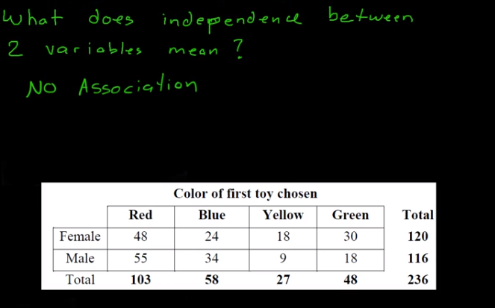
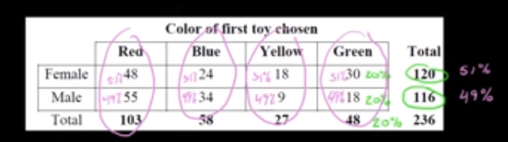
Eg:-
In this example there is no association between gender and color any gender can choose any toy colr

Slide 17
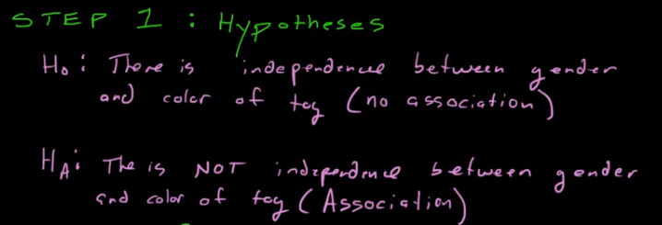


Slide 18
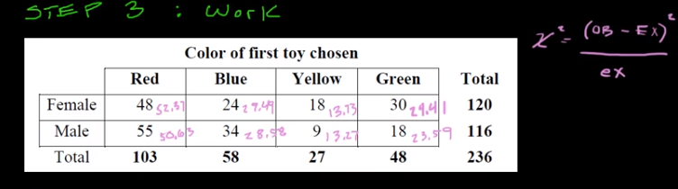
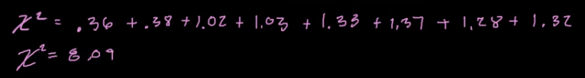

120*48/236=24.4
116*48/236=23.59
120*58/236=29.49

Slide 19
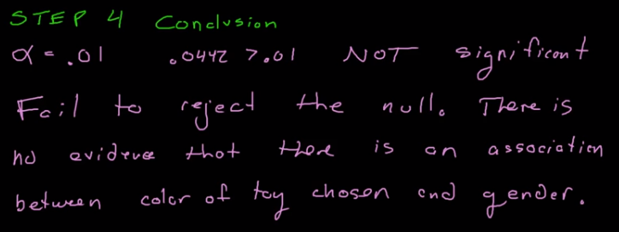

If we choose alpha is 0.05 ;0.0442 is lessthan 0.05 so we can say there is a significant association between color of toy chosen and gender.

Slide 20
> x<-head(read.csv("d:/mf.csv"))
> chisq.test(x,correct=F)
Pearson's Chi-squared test
data: x
X-squared = 33.993, df = 5, p-value = 2.389e-06
>

Slide 21
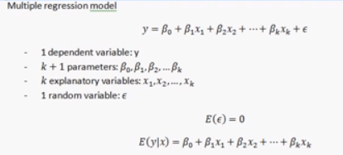
MULTIPLE REGRESSION
Multiple regression is used in predictive analytics

Slide 22
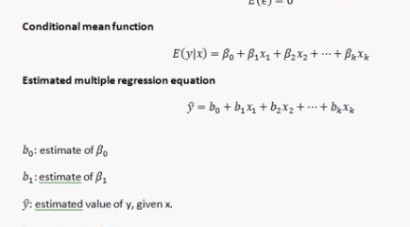
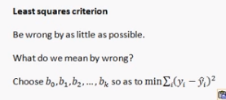


Slide 23
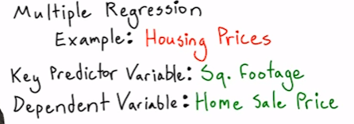
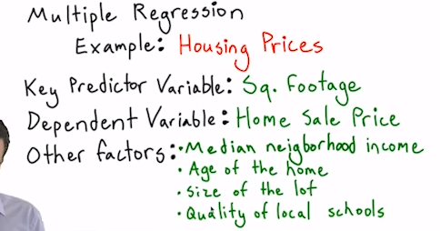

Slide 24
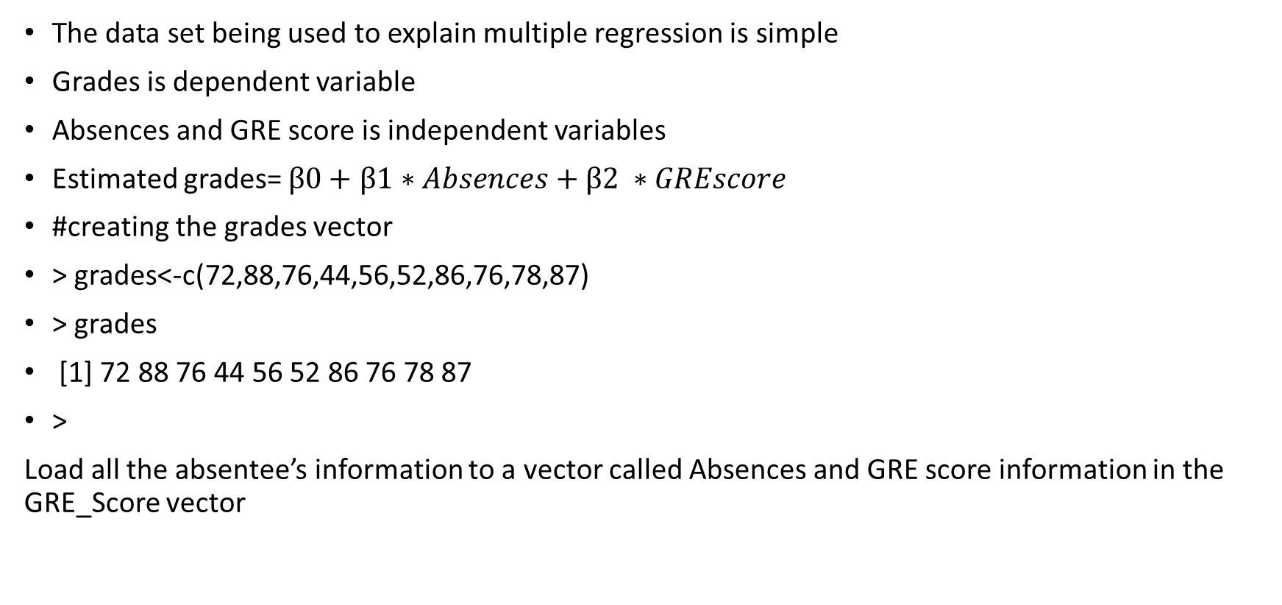
Example in R program

Slide 25
> grades<-c(72,88,76,44,56,52,86,76,78,87)
> grades
[1] 72 88 76 44 56 52 86 76 78 87
> Absences<-c(4,3,2,1,1,4,5,2,3,1)
> Absences
[1] 4 3 2 1 1 4 5 2 3 1
> GRE_Score<-c(525,654,465,554,745,750,582,722,484,556)
> GRE_Score
[1] 525 654 465 554 745 750 582 722 484 556
>
Another table called regression is created using linear model function lm

Slide 26
#creation of regression
> regression<-lm(grades~Absences+GRE_Score)
> regression
Call:
lm(formula = grades ~ Absences + GRE_Score)
Coefficients:
(Intercept) Absences GRE_Score
91.34520 2.93661 -0.04552
>
#The summary of regression results are:

Slide 27
> summary(regression)
Call:
lm(formula = grades ~ Absences + GRE_Score)
Residuals:
Min 1Q Median 3Q Max
-25.0638 -6.4876 -0.0875 10.3513 18.0273
Coefficients:
Estimate Std. Error t value Pr(>|t|)
(Intercept) 91.34520 32.40567 2.819 0.0258 *
Absences 2.93661 3.73927 0.785 0.4580
GRE_Score -0.04552 0.05001 -0.910 0.3930
---
Signif. codes: 0 ‘***’ 0.001 ‘**’ 0.01 ‘*’ 0.05 ‘.’ 0.1 ‘ ’ 1
Residual standard error: 16.03 on 7 degrees of freedom
Multiple R-squared: 0.1757, Adjusted R-squared: -0.05987
F-statistic: 0.7458 on 2 and 7 DF, p-value: 0.5086
>

Slide 28
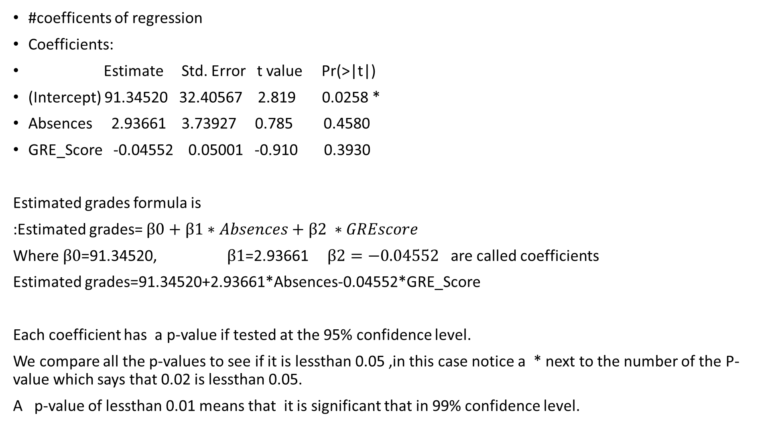

Slide 29
P-value
Residual standard error: 16.03 on 7 degrees of freedom
Multiple R-squared: 0.1757, Adjusted R-squared: -0.05987
F-statistic: 0.7458 on 2 and 7 DF, p-value: 0.5086
There is also a P-value for the entire equation which gives us the value of R-squared as 0.1757 it is called the multiple R-squared and the last item of interest is the standard error, a residual standard error that is exactly the same as the standard error of estimate.

Slide 30
TIME SERIES ANALYSIS
Time is one of the most critical elements for achieving business goals at a faster rate.
Due to the advancements and innovations in information technology there are many powerful tools and techniques developed to quicken our day-to-day activities of developing software to manage time in an efficient way
There are innovations in the ‘Bigdata’ field in the form of predictions and forecasting
Eg;_Time series modelling :in this method we are able to work on time-based data(like years,days,hours,minutes)and some of shrouded bits of knowledge are concluded to make informed decision making.
Eg:-when we have data that are serially correlated timeseries modelling is very useful.
Displaying stocks and shares data on a dashboard with a timeline.
Timeseries decomposition is breaking down of the timeseries data in to various components such as trend,seasonal,cyclical and irregular forms.
To demonstrate timeseries in R programming first we shall decompose a time series in to components such as seasonal,trend,and irregular by considering moving averages

Slide 31
Syntax for decompose:-
Decompose(x,type=c(“additive”, “multiplicative”), filter=NULL)
Where x: a timeseries model
Type: the type of the seasonal component used
Filter: a vector containing filter coefficients represented using reverse time order(as for AR or MA coefficients) that are used to filter the seasonal component; if it is given as NULL a moving average with symmetric window is executed.

Slide 32
> data()
> datasets::AirPassengers
Jan Feb Mar Apr May Jun Jul Aug Sep Oct Nov Dec
1949 112 118 132 129 121 135 148 148 136 119 104 118
1950 115 126 141 135 125 149 170 170 158 133 114 140
1951 145 150 178 163 172 178 199 199 184 162 146 166
1952 171 180 193 181 183 218 230 242 209 191 172 194
1953 196 196 236 235 229 243 264 272 237 211 180 201
1954 204 188 235 227 234 264 302 293 259 229 203 229
1955 242 233 267 269 270 315 364 347 312 274 237 278
1956 284 277 317 313 318 374 413 405 355 306 271 306
1957 315 301 356 348 355 422 465 467 404 347 305 336
1958 340 318 362 348 363 435 491 505 404 359 310 337
1959 360 342 406 396 420 472 548 559 463 407 362 405
1960 417 391 419 461 472 535 622 606 508 461 390 432

Slide 33
> f<-decompose(AirPassengers)
> f
$`x`
Jan Feb Mar Apr May Jun Jul Aug Sep Oct Nov Dec
1949 112 118 132 129 121 135 148 148 136 119 104 118
1950 115 126 141 135 125 149 170 170 158 133 114 140
1951 145 150 178 163 172 178 199 199 184 162 146 166
1952 171 180 193 181 183 218 230 242 209 191 172 194
1953 196 196 236 235 229 243 264 272 237 211 180 201
1954 204 188 235 227 234 264 302 293 259 229 203 229
1955 242 233 267 269 270 315 364 347 312 274 237 278
1956 284 277 317 313 318 374 413 405 355 306 271 306
1957 315 301 356 348 355 422 465 467 404 347 305 336
1958 340 318 362 348 363 435 491 505 404 359 310 337
1959 360 342 406 396 420 472 548 559 463 407 362 405
1960 417 391 419 461 472 535 622 606 508 461 390 432

Slide 34
$seasonal
Jan Feb Mar Apr May Jun Jul
1949 -24.748737 -36.188131 -2.241162 -8.036616 -4.506313 35.402778 63.830808
1950 -24.748737 -36.188131 -2.241162 -8.036616 -4.506313 35.402778 63.830808
1951 -24.748737 -36.188131 -2.241162 -8.036616 -4.506313 35.402778 63.830808
1952 -24.748737 -36.188131 -2.241162 -8.036616 -4.506313 35.402778 63.830808
1953 -24.748737 -36.188131 -2.241162 -8.036616 -4.506313 35.402778 63.830808
1954 -24.748737 -36.188131 -2.241162 -8.036616 -4.506313 35.402778 63.830808
1955 -24.748737 -36.188131 -2.241162 -8.036616 -4.506313 35.402778 63.830808
1956 -24.748737 -36.188131 -2.241162 -8.036616 -4.506313 35.402778 63.830808
1957 -24.748737 -36.188131 -2.241162 -8.036616 -4.506313 35.402778 63.830808
1958 -24.748737 -36.188131 -2.241162 -8.036616 -4.506313 35.402778 63.830808
1959 -24.748737 -36.188131 -2.241162 -8.036616 -4.506313 35.402778 63.830808
1960 -24.748737 -36.188131 -2.241162 -8.036616 -4.506313 35.402778 63.830808

Slide 35
Aug Sep Oct Nov Dec
1949 62.823232 16.520202 -20.642677 -53.593434 -28.619949
1950 62.823232 16.520202 -20.642677 -53.593434 -28.619949
1951 62.823232 16.520202 -20.642677 -53.593434 -28.619949
1952 62.823232 16.520202 -20.642677 -53.593434 -28.619949
1953 62.823232 16.520202 -20.642677 -53.593434 -28.619949
1954 62.823232 16.520202 -20.642677 -53.593434 -28.619949
1955 62.823232 16.520202 -20.642677 -53.593434 -28.619949
1956 62.823232 16.520202 -20.642677 -53.593434 -28.619949
1957 62.823232 16.520202 -20.642677 -53.593434 -28.619949
1958 62.823232 16.520202 -20.642677 -53.593434 -28.619949
1959 62.823232 16.520202 -20.642677 -53.593434 -28.619949
1960 62.823232 16.520202 -20.642677 -53.593434 -28.619949

Slide 36
$trend
Jan Feb Mar Apr May Jun Jul Aug Sep
1949 NA NA NA NA NA NA 126.7917 127.2500 127.9583
1950 131.2500 133.0833 134.9167 136.4167 137.4167 138.7500 140.9167 143.1667 145.7083
1951 157.1250 159.5417 161.8333 164.1250 166.6667 169.0833 171.2500 173.5833 175.4583
1952 183.1250 186.2083 189.0417 191.2917 193.5833 195.8333 198.0417 199.7500 202.2083
1953 215.8333 218.5000 220.9167 222.9167 224.0833 224.7083 225.3333 225.3333 224.9583
1954 228.0000 230.4583 232.2500 233.9167 235.6250 237.7500 240.5000 243.9583 247.1667
1955 261.8333 266.6667 271.1250 275.2083 278.5000 281.9583 285.7500 289.3333 293.2500
1956 309.9583 314.4167 318.6250 321.7500 324.5000 327.0833 329.5417 331.8333 334.4583
1957 348.2500 353.0000 357.6250 361.3750 364.5000 367.1667 369.4583 371.2083 372.1667
1958 375.2500 377.9167 379.5000 380.0000 380.7083 380.9583 381.8333 383.6667 386.5000
1959 402.5417 407.1667 411.8750 416.3333 420.5000 425.5000 430.7083 435.1250 437.7083
1960 456.3333 461.3750 465.2083 469.3333 472.7500 475.0417 NA NA NA
Oct Nov Dec
1949 128.5833 129.0000 129.7500
1950 148.4167 151.5417 154.7083
1951 176.8333 178.0417 180.1667
1952 206.2500 210.4167 213.3750
1953 224.5833 224.4583 225.5417
1954 250.2500 253.5000 257.1250
1955 297.1667 301.0000 305.4583
1956 337.5417 340.5417 344.0833
1957 372.4167 372.7500 373.6250
1958 390.3333 394.7083 398.6250
1959 440.9583 445.8333 450.6250
1960 NA NA NA
$random
Jan Feb Mar Apr May Jun Jul
1949 NA NA NA NA NA NA -42.6224747
1950 8.4987374 29.1047980 8.3244949 6.6199495 -7.9103535 -25.1527778 -34.7474747
1951 12.6237374 26.6464646 18.4078283 6.9116162 9.8396465 -26.4861111 -36.0808081
1952 12.6237374 29.9797980 6.1994949 -2.2550505 -6.0770202 -13.2361111 -31.8724747
1953 4.9154040 13.6881313 17.3244949 20.1199495 9.4229798 -17.1111111 -25.1641414
1954 0.7487374 -6.2702020 4.9911616 1.1199495 2.8813131 -9.1527778 -2.3308081
1955 4.9154040 2.5214646 -1.8838384 1.8282828 -3.9936869 -2.3611111 14.4191919
1956 -1.2095960 -1.2285354 0.6161616 -0.7133838 -1.9936869 11.5138889 19.6275253
1957 -8.5012626 -15.8118687 0.6161616 -5.3383838 -4.9936869 19.4305556 31.7108586
1958 -10.5012626 -23.7285354 -15.2588384 -23.9633838 -13.2020202 18.6388889 45.3358586
1959 -17.7929293 -28.9785354 -3.6338384 -12.2967172 4.0063131 11.0972222 53.4608586
1960 -14.5845960 -34.1868687 -43.9671717 -0.2967172 3.7563131 24.5555556 NA
Aug Sep Oct Nov Dec
1949 -42.0732323 -8.4785354 11.0593434 28.5934343 16.8699495
1950 -35.9898990 -4.2285354 5.2260101 16.0517677 13.9116162
1951 -37.4065657 -7.9785354 5.8093434 21.5517677 14.4532828
1952 -20.5732323 -9.7285354 5.3926768 15.1767677 9.2449495
1953 -16.1565657 -4.4785354 7.0593434 9.1351010 4.0782828
1954 -13.7815657 -4.6868687 -0.6073232 3.0934343 0.4949495
1955 -5.1565657 2.2297980 -2.5239899 -10.4065657 1.1616162
1956 10.3434343 4.0214646 -10.8989899 -15.9482323 -9.4633838
1957 32.9684343 15.3131313 -4.7739899 -14.1565657 -9.0050505
1958 58.5101010 0.9797980 -10.6906566 -31.1148990 -33.0050505
1959 61.0517677 8.7714646 -13.3156566 -30.2398990 -17.0050505
1960 NA NA NA NA NA
$figure
[1] -24.748737 -36.188131 -2.241162 -8.036616 -4.506313 35.402778 63.830808
[8] 62.823232 16.520202 -20.642677 -53.593434 -28.619949
$type
[1] "additive"
attr(,"class")
[1] "decomposed.ts"
>

Slide 37
Oct Nov Dec
1949 128.5833 129.0000 129.7500
1950 148.4167 151.5417 154.7083
1951 176.8333 178.0417 180.1667
1952 206.2500 210.4167 213.3750
1953 224.5833 224.4583 225.5417
1954 250.2500 253.5000 257.1250
1955 297.1667 301.0000 305.4583
1956 337.5417 340.5417 344.0833
1957 372.4167 372.7500 373.6250
1958 390.3333 394.7083 398.6250
1959 440.9583 445.8333 450.6250
1960 NA NA NA

Slide 38
$random
Jan Feb Mar Apr May Jun Jul
1949 NA NA NA NA NA NA -42.6224747
1950 8.4987374 29.1047980 8.3244949 6.6199495 -7.9103535 -25.1527778 -34.7474747
1951 12.6237374 26.6464646 18.4078283 6.9116162 9.8396465 -26.4861111 -36.0808081
1952 12.6237374 29.9797980 6.1994949 -2.2550505 -6.0770202 -13.2361111 -31.8724747
1953 4.9154040 13.6881313 17.3244949 20.1199495 9.4229798 -17.1111111 -25.1641414
1954 0.7487374 -6.2702020 4.9911616 1.1199495 2.8813131 -9.1527778 -2.3308081
1955 4.9154040 2.5214646 -1.8838384 1.8282828 -3.9936869 -2.3611111 14.4191919
1956 -1.2095960 -1.2285354 0.6161616 -0.7133838 -1.9936869 11.5138889 19.6275253
1957 -8.5012626 -15.8118687 0.6161616 -5.3383838 -4.9936869 19.4305556 31.7108586
1958 -10.5012626 -23.7285354 -15.2588384 -23.9633838 -13.2020202 18.6388889 45.3358586
1959 -17.7929293 -28.9785354 -3.6338384 -12.2967172 4.0063131 11.0972222 53.4608586
1960 -14.5845960 -34.1868687 -43.9671717 -0.2967172 3.7563131 24.5555556 NA

Slide 39
Aug Sep Oct Nov Dec
1949 -42.0732323 -8.4785354 11.0593434 28.5934343 16.8699495
1950 -35.9898990 -4.2285354 5.2260101 16.0517677 13.9116162
1951 -37.4065657 -7.9785354 5.8093434 21.5517677 14.4532828
1952 -20.5732323 -9.7285354 5.3926768 15.1767677 9.2449495
1953 -16.1565657 -4.4785354 7.0593434 9.1351010 4.0782828
1954 -13.7815657 -4.6868687 -0.6073232 3.0934343 0.4949495
1955 -5.1565657 2.2297980 -2.5239899 -10.4065657 1.1616162
1956 10.3434343 4.0214646 -10.8989899 -15.9482323 -9.4633838
1957 32.9684343 15.3131313 -4.7739899 -14.1565657 -9.0050505
1958 58.5101010 0.9797980 -10.6906566 -31.1148990 -33.0050505
1959 61.0517677 8.7714646 -13.3156566 -30.2398990 -17.0050505
1960 NA NA NA NA NA

Slide 40
$figure
[1] -24.748737 -36.188131 -2.241162 -8.036616 -4.506313 35.402778 63.830808
[8] 62.823232 16.520202 -20.642677 -53.593434 -28.619949
$type
[1] "additive"
attr(,"class")
[1] "decomposed.ts"
>

Slide 41
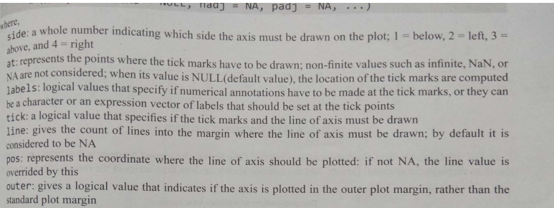
Get the seasonal figures from 1949 to 1961 and plot the figures.x axis be the names of months and the axis function is used to add and axis to the present plot,permitting the detail of the side,position,names as shown in fig:the syntax
Axis(side,at=NULL,labels=TRUE,tick=TRUE,line=NA, pos=NA, outer=FALSE, font=NA, lty=“solid”,lwd=1,lwd.ticks=lwd,col=NULL,col.ticks=NULL,hadj=NA,padj=NA,…)

Slide 42
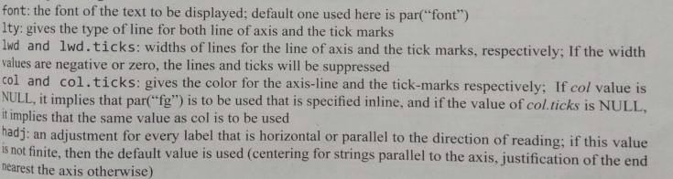
Axis(side,at=NULL,labels=TRUE,tick=TRUE,line=NA, pos=NA, outer=FALSE, font=NA, lty=“solid”,lwd=1,lwd.ticks=lwd,col=NULL,col.ticks=NULL,hadj=NA,padj=NA,…)

Slide 43
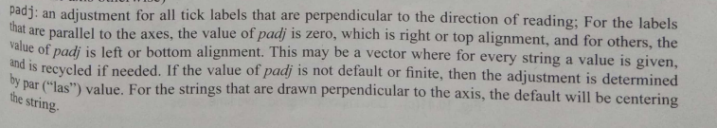
Axis(side,at=NULL,labels=TRUE,tick=TRUE,line=NA, pos=NA, outer=FALSE, font=NA, lty=“solid”,lwd=1,lwd.ticks=lwd,col=NULL,col.ticks=NULL,hadj=NA,padj=NA,…)

Slide 44
Plot the figures :
> plot(f$figure,type="b",xaxt="n",xlabs="")
Warning messages:
1: In plot.window(...) : "xlabs" is not a graphical parameter
2: In plot.xy(xy, type, ...) : "xlabs" is not a graphical parameter
3: In axis(side = side, at = at, labels = labels, ...) :
"xlabs" is not a graphical parameter
4: In axis(side = side, at = at, labels = labels, ...) :
"xlabs" is not a graphical parameter
5: In box(...) : "xlabs" is not a graphical parameter
6: In title(...) : "xlabs" is not a graphical parameter
> monthnames<-months(ISOdate(2011,1:12,1))
> axis(1,at=1:12,labels=monthnames,las=2)
>

Slide 45
